Slide 1

Unleash Your Inner Chef: Mastering the Art of AI Recipe Prompts
Welcome to a culinary adventure where technology meets gastronomy. We'll delve into the world of AI recipe prompts, uncovering secrets to create delicious dishes with ease.
MH
by Makkena Venkata Harshitha

Slide 2
The Anatomy of an AI Recipe Prompt: Dissecting the Core Components
Word Count
Recipe Topic
Tone
Set the desired length of the recipe. Aim for concise, digestible recipes. Specify a word count to control the recipe's length.
Clearly define the dish you want to create. Be specific with the type of cuisine, ingredients, and desired flavor profile.
Set the overall mood. Would you prefer a casual, professional, or humorous tone? Tone influences the recipe's style and voice.

Slide 3
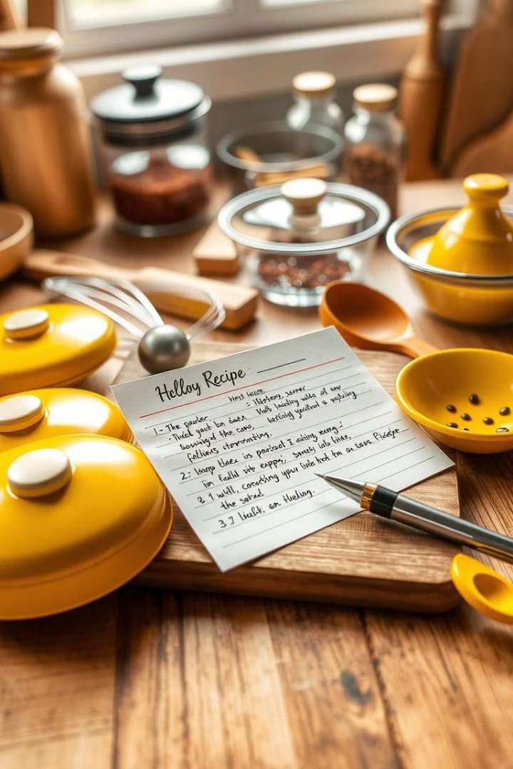
Crafting the Perfect Prompt: Word Count, Recipe Topic, and Tone
Specify the desired word count for the recipe. Aim for concise and digestible content.
Be specific with the type of cuisine, ingredients, and flavor profile. For example, "spicy Thai curry" or "vegan chocolate cake."
Set the desired tone of the recipe, such as casual, professional, or humorous. The tone influences the voice and style.

Slide 4

Beyond the Basics: Injecting Personality and Humor into Your Prompts
Add personality to your prompts by specifying your preferred cooking style, like "rustic" or "refined."
Include specific requests for the recipe's structure, like "step-by-step instructions" or "tips for beginners."
Inject humor with witty prompts like "a recipe for a dish that would impress your picky eater" or "a recipe that is so easy, even a dog could cook it."

Slide 5



From Prompt to Plate: Real-World Examples and Recipe Showcases
Prompt: Generate a 300-word recipe for creamy mushroom pasta with a touch of truffle oil, focusing on a casual tone and including helpful tips for beginners.
Prompt: Create a 500-word recipe blog for a decadent chocolate cake with a focus on a professional tone, highlighting the history of the dessert and providing elegant serving suggestions.

Slide 6

Next Steps and Key Takeaways: Level Up Your AI Recipe Game
1
Explore different recipe prompt generators. Experiment with various platforms and find one that suits your needs.
2
Become familiar with the nuances of prompt engineering. Learn to craft precise, descriptive prompts to achieve the desired results.
3
Don't be afraid to experiment and have fun. The beauty of AI recipe prompts lies in their endless possibilities.

Slide 7
Thank You
Thank you for joining us on this culinary journey. We hope you feel inspired to explore the world of AI recipe prompts and unleash your inner chef.

